Slide 1
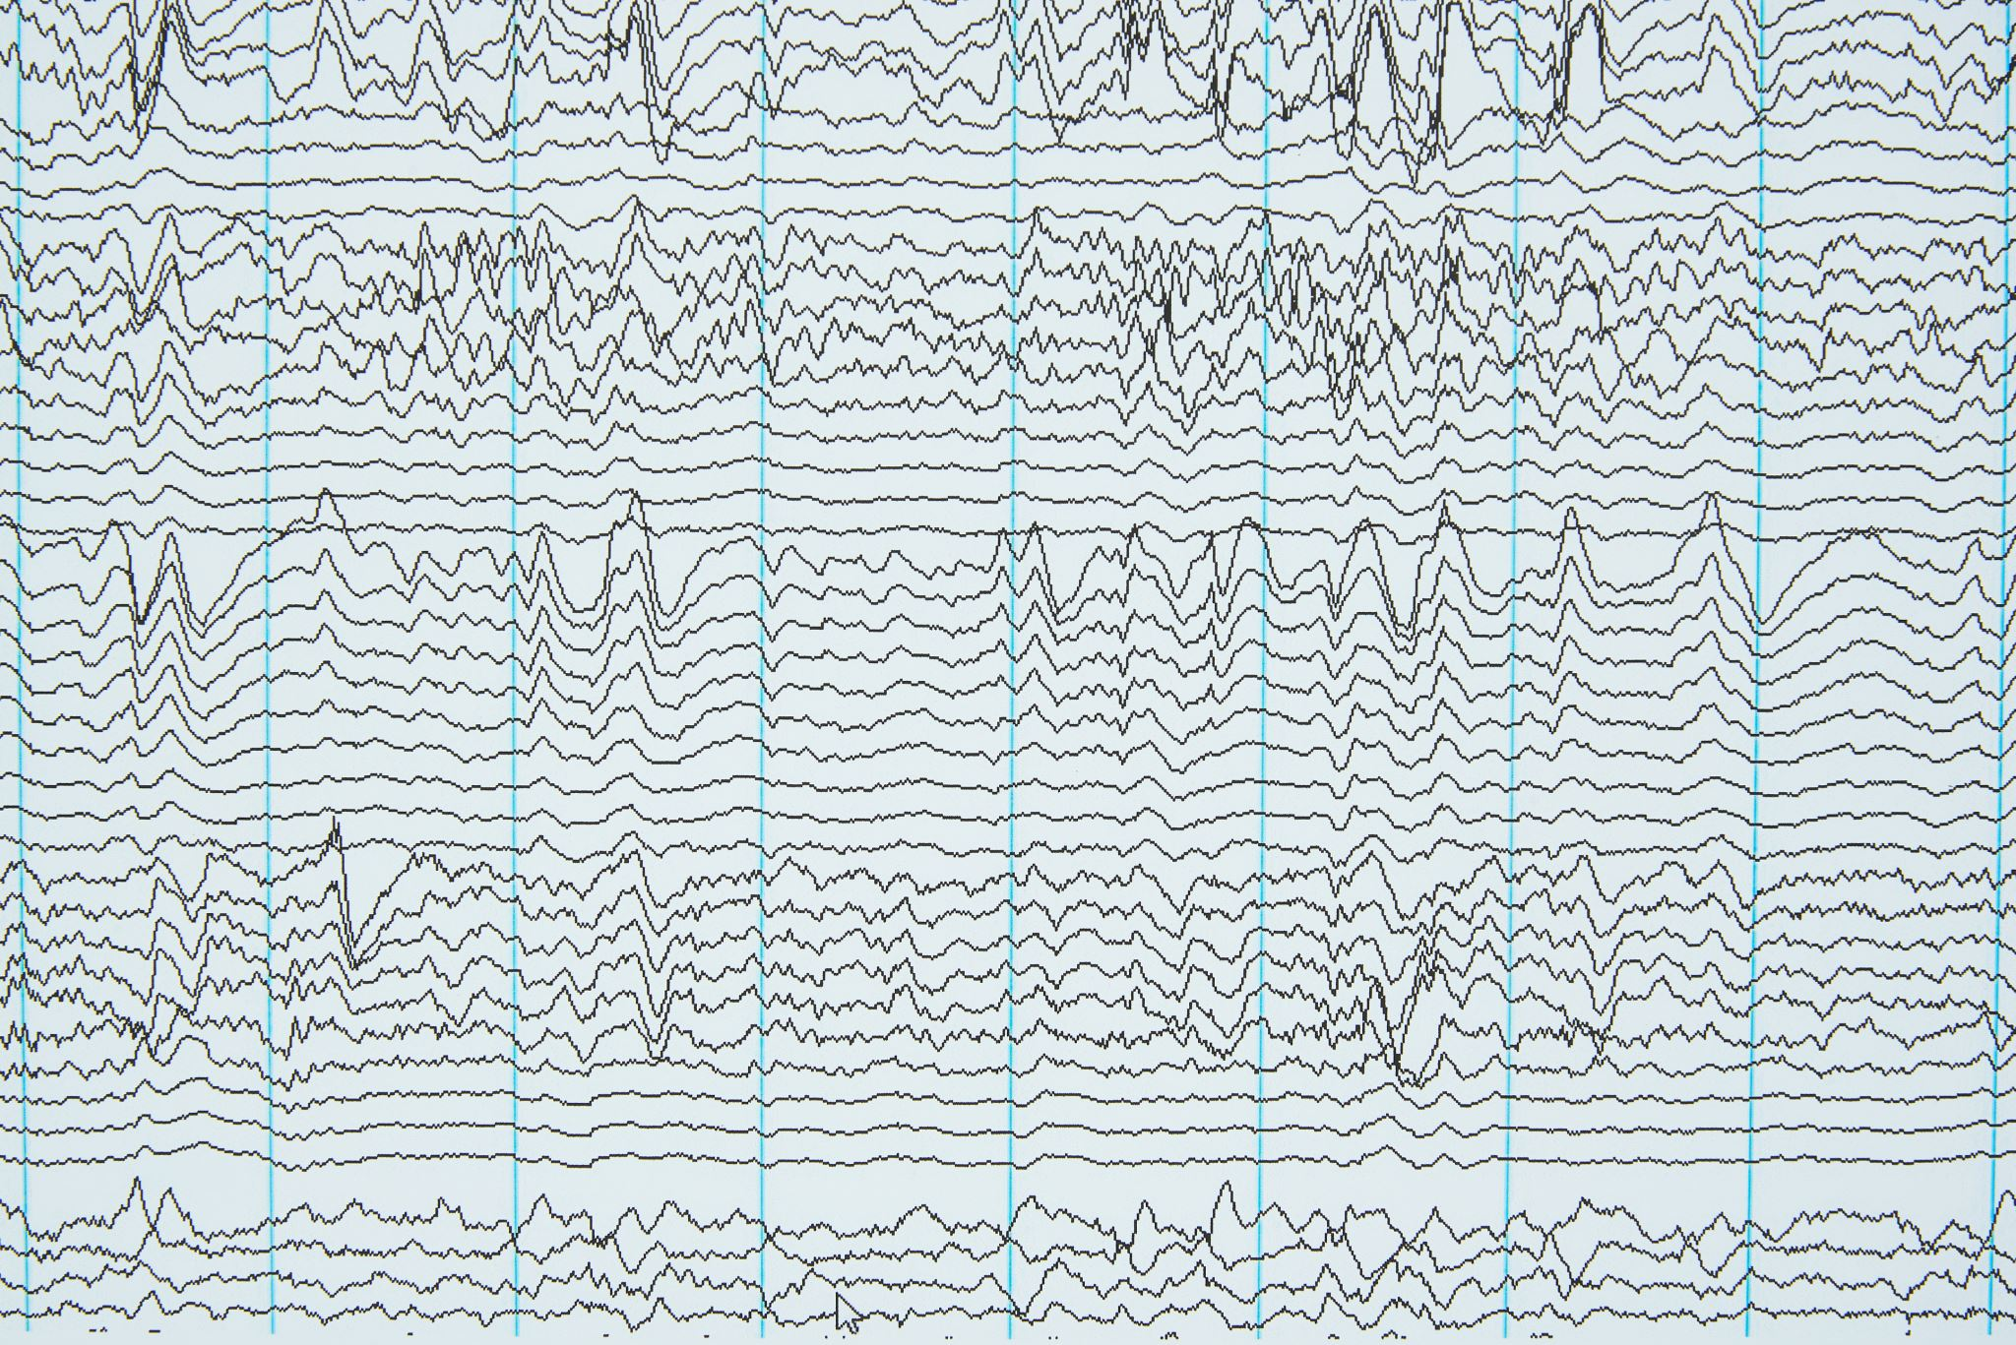
Eye state prediction based on EEG signal
Abdul Mateen
Ishpreet Kaur Sethi
Nirvaya Deoja
Vignesh Sivakumar

Slide 2
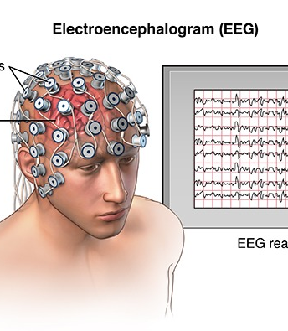
INTRODUCTION
An EEG is a test that detects abnormalities in your brain waves, or in the electrical activity of your brain.
During the procedure, electrodes consisting of small metal discs with thin wires are pasted onto your scalp.
The electrodes detect tiny electrical charges that result from the activity of your brain cells.
The charges are amplified and appear as a graph on a computer screen, or as a recording that may be printed out on paper.
There are 21 electrodes placed at relative distances between cranial landmarks over the head.

Slide 3
PROBLEM STATEMENT
An EEG was specifically recorded of a single person was made for 117 seconds while the subject closed and opened their eyes, which was captured on video.
Through this project, we wanted to focus the problems involving predicting whether subjects' eyes are closed or open based on brain wave data.
We will be taking into account all 14 features to classify the state of the eye by implementing multiple machine learning algorithms.

Slide 4
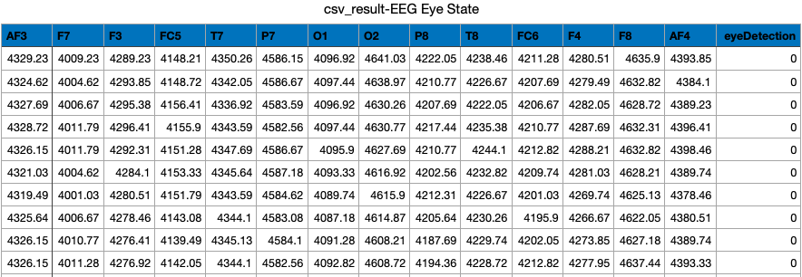
About the Dataset
All data is from one continuous EEG measurement with the Emotive EEG Neuroheadset. The duration of the measurement was 117 seconds.
DATA DESCRIPTION:
Number of Features: 15 Number of Instances: 14,980

Slide 5
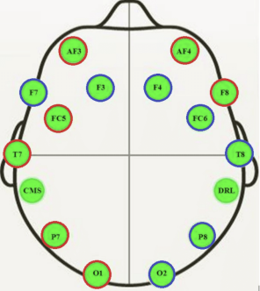
DESCRIPTION OF FEATURES
AF3: Anterior frontal (AF) electrode present on the left hemisphere between AFz and AF7
F7: Frontal electrode present on the left hemisphere between F9 and F5
F3: Frontal electrode present on the left hemisphere between F5 and F1
FC5: Frontocentral electrode present on the left hemisphere between FT7 and FC3
T7: Temporal electrode present on the left hemisphere between T9 and C5
P7: Posterior temporal electrode present on the left hemisphere between P9 and P5
O1: Occipital electrode present on the left hemisphere between PO7 and Oz
O2: Occipital electrode present on the right hemisphere between Oz and PO8
P8: Posterior temporal electrode present on the right hemisphere between P6 and P10
T8: Temporal electrode present on the right hemisphere between C6 and T10
FC6: Frontocentral electrode present on the right hemisphere between FC4 and FT8
F4: Frontal electrode present on the right hemisphere between F2 and F6
F8: Frontal electrode present on the right hemisphere between F6 and F10
AF4: Anterior frontal electrode present on the right hemisphere between AFz and AF8
eyeDetection: Used to denote the state of the eye: '0' indicates eye-closed & '1' eye-open state.

Slide 6
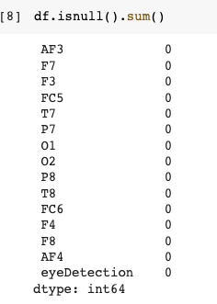
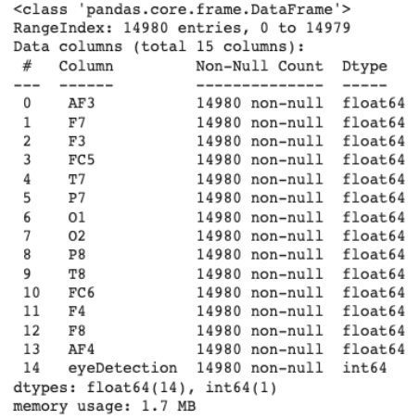
Feature Engineering:
Step 1: Understanding the datatypes of the features
Step 2: Understanding the range of the features
Step 3: Detecting the outliers and removing them based on mean and standard deviation
Step 4: Removing highly correlated features
Step 5: Statistical Analysis

Slide 7
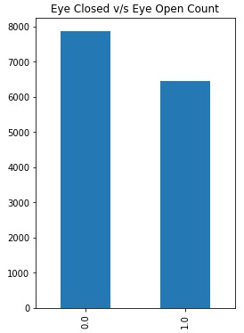
Bar Graph to display the target distribution of our dataset which is ‘eye Detection’
Observations:
Eyes Closed data count is more than eyes open data points.
It can be inferred that mostly the Eye State was closed, but the data points still seem to be balanced.

Slide 8
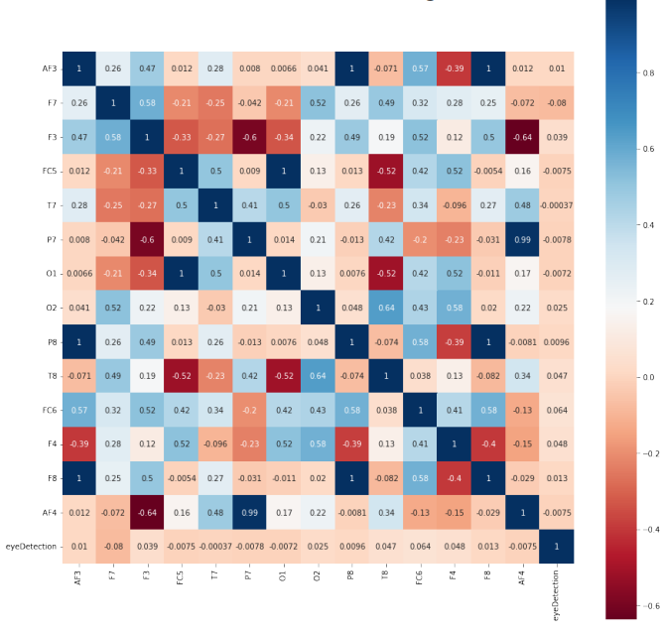
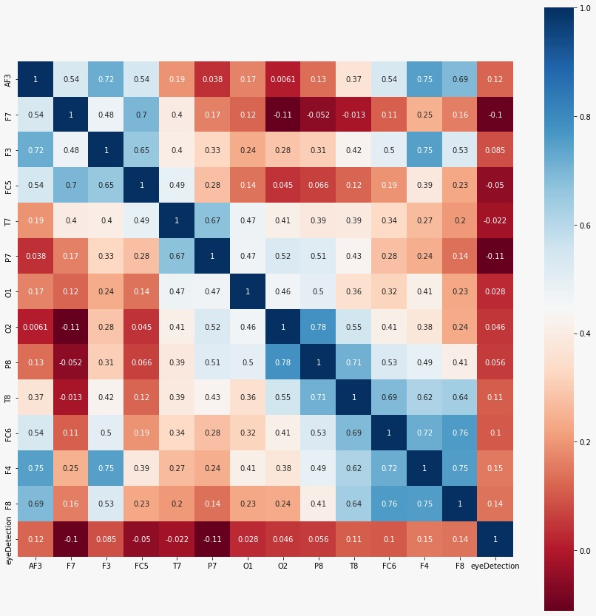
Heat map to depict the correlation between features
before
After
Columns AF4 and eye Detection were highly correlated.
Hence, we removed the columns so that moving forward we have true and balanced predictions

Slide 9
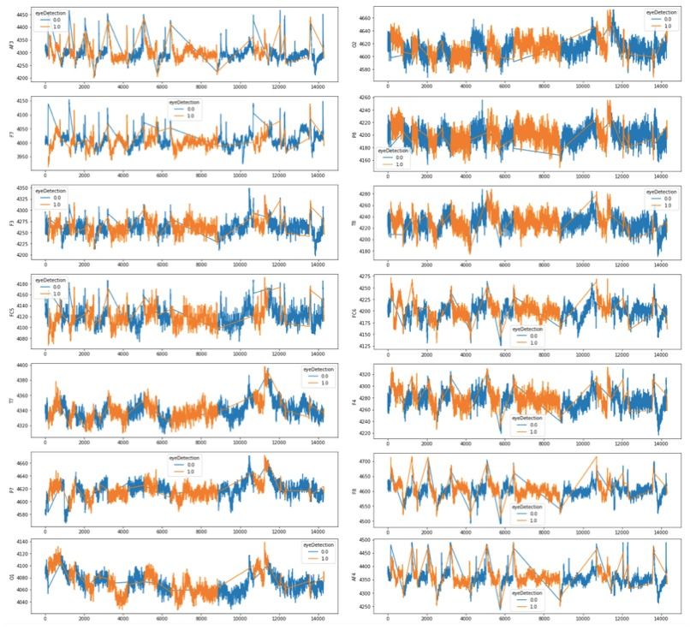
Feature display after removing outliers
After plotting the line graph, we noticed that in most of our features were displayed flat or with very high values. these values may be outliers. We then removed the outliers to check the subject difference.
We can now clearly see the difference between our two-line plots. The variations are clearly displayed now with respect to our target feature - ‘eye Detection’. The graph above plots the time series of each feature and the Eye State of a person, that is, Closed or Open.

Slide 10
SPLITTING THE DATASET
Training data - 70%
Testing - 30%.
We split our data in ratios of 70 and 30. This step was undertaken to split the dataset into a train and test set, this helps us get rid of any inherent bias, judge the true model performance, and prevent the data from overfitting.

Slide 11
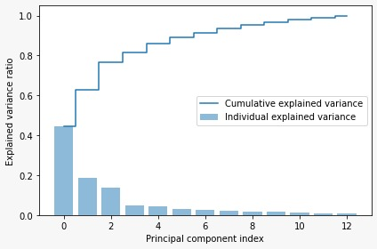
Principal Component Analysis (PCA)
Algorithm Performed:
1.Calculating mean values of each column and making the values mean-centered
2.Determining the covariance matrix to identify correlations
3.Computing the Eigenvalues and Eigenvectors of the covariance matrix
4.Determining the explained Matrix
5. Plotting the explained variance against cumulative explained variance

Slide 12
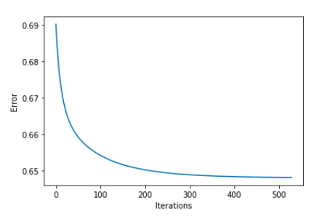
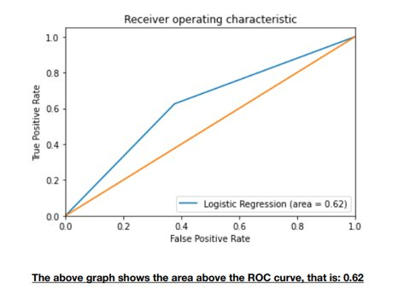
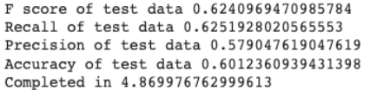
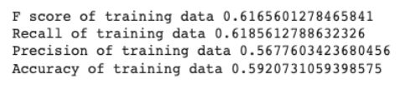
LOGISTIC REGRESSION
Algorithm performed:
Splitting the original dataset into Train and Test data (0.7: 0.3) to perform logistic regression.
Using Sigmoid Function: The logistic function in linear regression is a type of sigmoid, which is a mathematical function that takes any real number and maps it to a probability between 0 and 1.
Using the process of gradient descent to find the global maximum
The graph displays the relationship between Iterations and Errors.

Slide 13
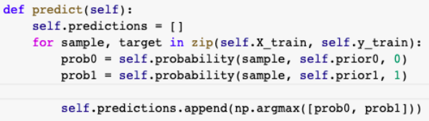
GAUSSIAN NAIVE BAYES
Algorithm performed:
We started by initializing the class for our train and test data to perform the model. We created a function to store our data in order to perform it with the Gaussian Naive Bayes distribution. We then found the mean and standard deviation and used them to put them to norm function.
We then calculated the priors of each class using the probability function
We finally calculate the probability of classes 0 and 1 using the predict function and assigned the maximum value to predict function.

Slide 14
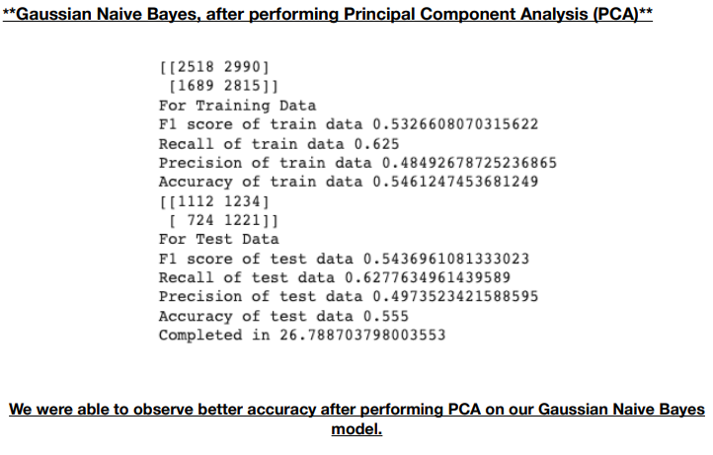
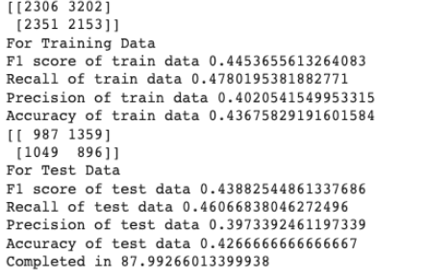
We then calculated our Train and Test Dataset's Accuracy, Recall, Precision and F1 score

Slide 15
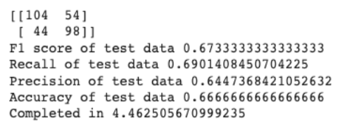
K-NEAREST NEIGHBOUR
Algorithm performed:
We began by finding the Euclidean distance between each data point and created arrays to store distances and looped through each training data to calculate the distance.
We then sorted the arrays while persevering the index and used argsort() to sort from lowest to highest, keeping the first K data points.
We then went on to calculate the majority votes to from the training data set and combine them to make predictions for our new data points.
We then moved to apply our prediction function to our test dataset and found the test data accuracy at 66.66%

Slide 16
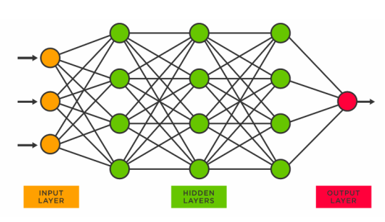
NEURAL NETWORKS
Algorithm performed:
We started with importing Keras and necessary libraries in a sequential form, we had three hidden layers, all with ‘relu’ 64, 32, and 16 nodes.
We had only one output layer because SVM is a classification problem.
3. We then moved to compile our model using Adam as an optimizer, where the loss function was binary cross entropy. Our findings for this model are based on the evaluation of the accuracy.
4. There are 10 epochs, and the 7th epoch is the optimal value as we can observe that after that point the accuracy starts to diverge, and the algorithm does not overfit.

Slide 17
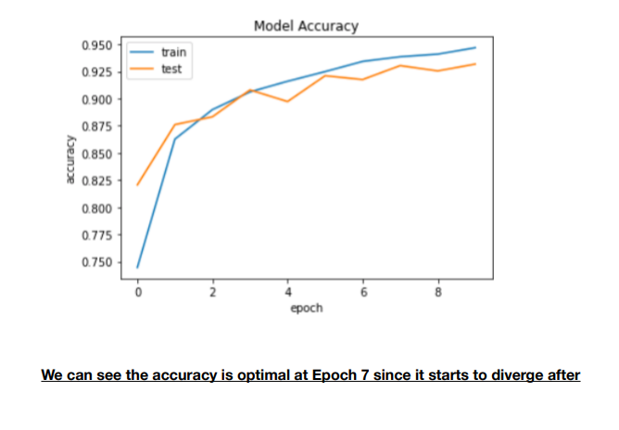
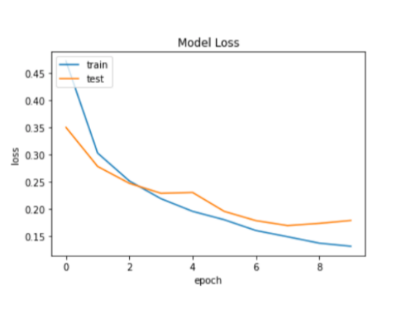

Slide 18
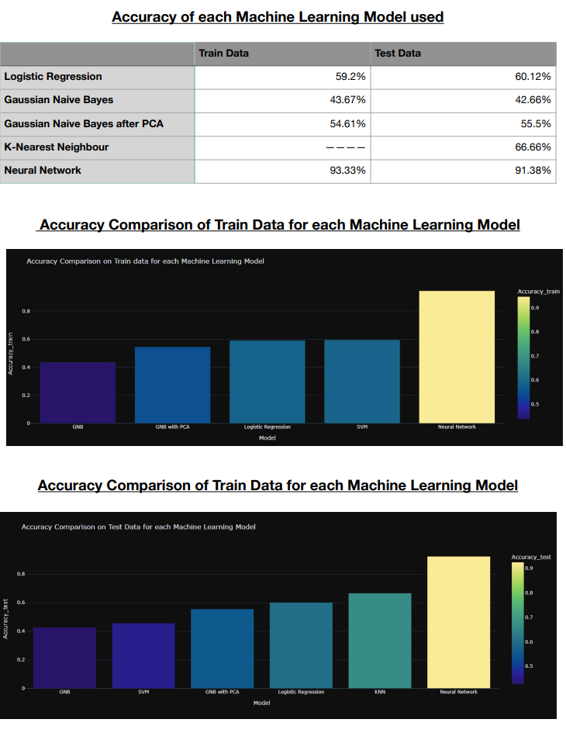
SUMMARY

Slide 19
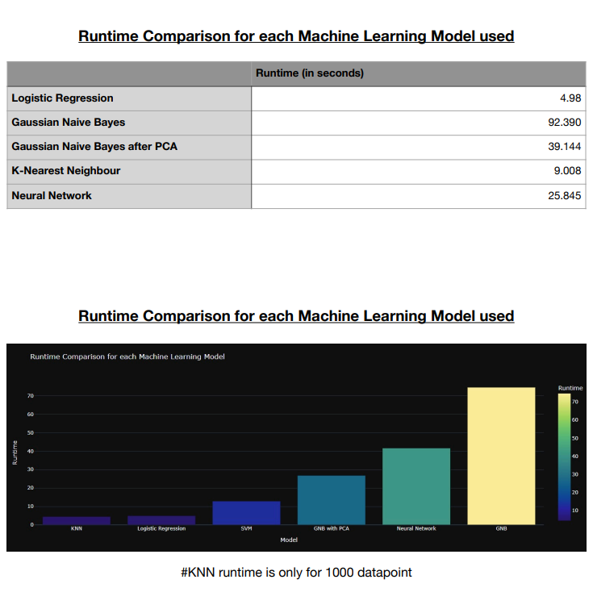

Slide 20
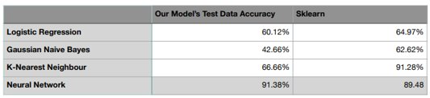
After comparing our model’s test data accuracy with sklearn:
**Our model’s increased accuracy on Neural networks is possible because all models performed against the MLP classifier constraints along with activation function ‘relu’ and binary cross-entropy for the loss function our Neural Networks perform better in accuracy.

Slide 21
Final results:
Logistic Regression performs well for our given dataset.
We performed Gaussian Naive Bayes using the predict function and then with PCA.
We found KNN to be very slow.
Neural Networks performed the best on data, as it does not overfit
Bias- Variance Tradeoff: Since all our machine learning models were balanced and did not overfit (there was not much difference in training and testing accuracy), we did not perform any sampling or cross-validation techniques to increase the accuracy.
CONCLUSION:
After the comparison of all our Machine Learning Models, we can conclude that Logistic Regression and Neural Networks performed the best for our given dataset.

Slide 22
Thank you!
Dataset Link: https://archive.ics.uci.edu/ml/datasets/EEG+Eye+State

